Slide 1

Software Group Project (SGP)-1
Team:
22CE093-NEEL PATEL
22CE098-SHREY PATEL
22CE106-POOJA RAMANI
22CE109-VEER RANA

Slide 2
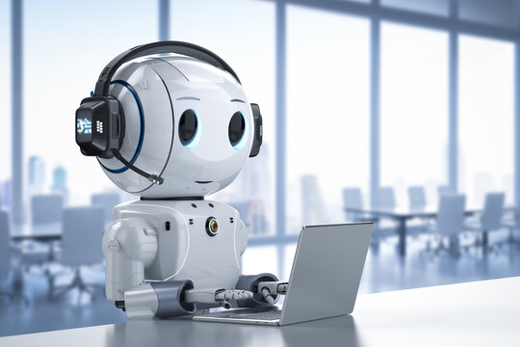
About our website:
Description : When user opens the website he/she can explore his/her needs of various robots and its equipment. If user wants to buy any product then he/she must login to our community for further purchasing phases. Also he/she needs to give advance 20% payment of grand total of purchase for any of this equipment, which would be made available within 3 days. Once the product is available the customer would be notified through email.

Slide 3
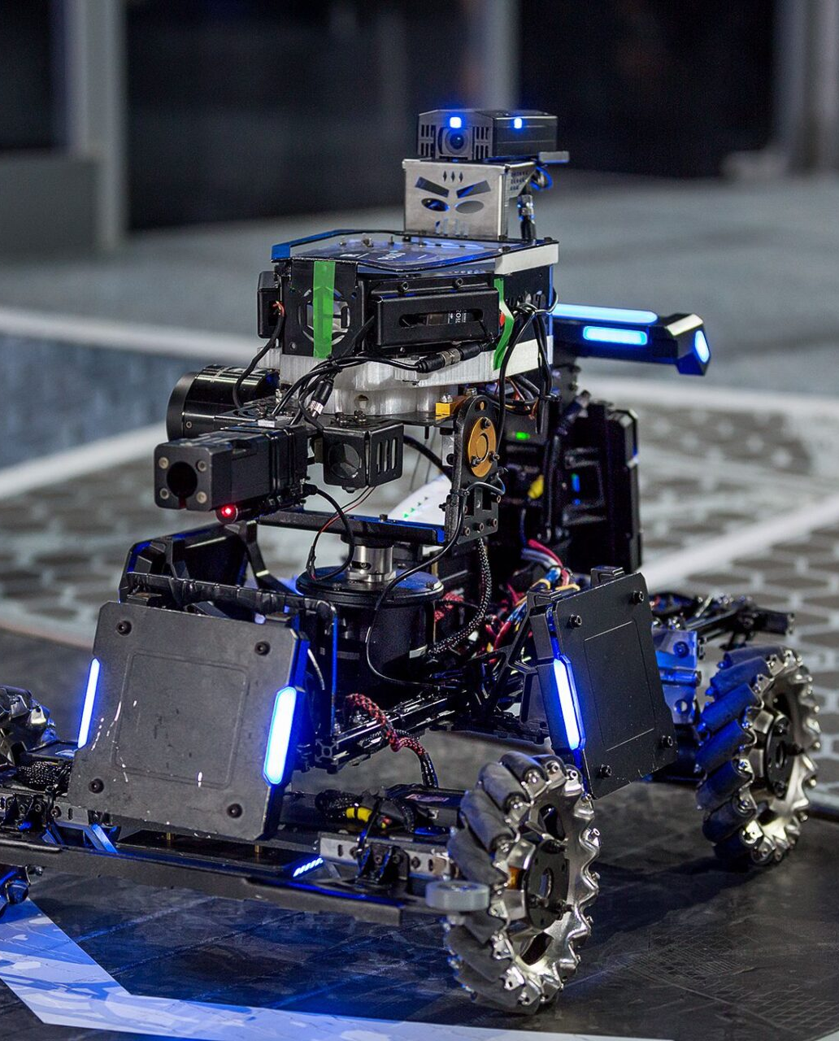
There are many type of robotics competition in like:
Robocon (ABU Robocon)
IIT Techfest Robotics Challenge
e-Yantra Robotics Competition
ROBOlympics
Indian Robot Olympiad (IRO) etc.

Slide 4

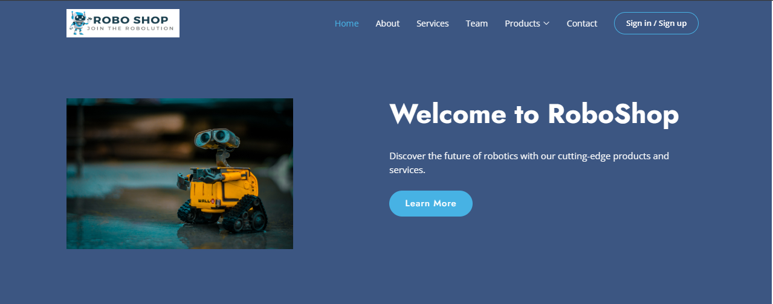

Homepage

Slide 5

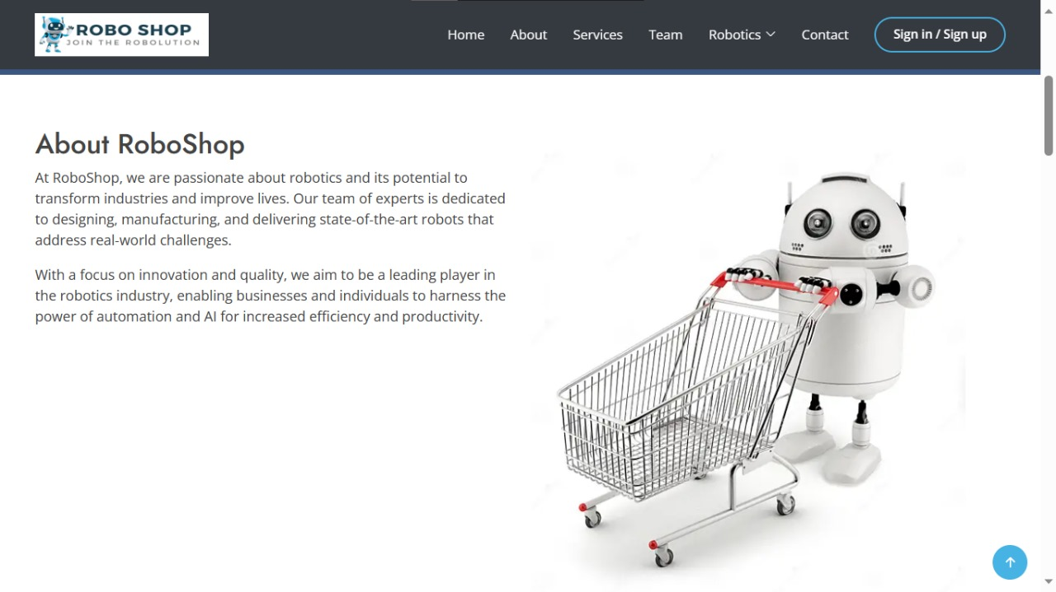
About Roboshop

Slide 6

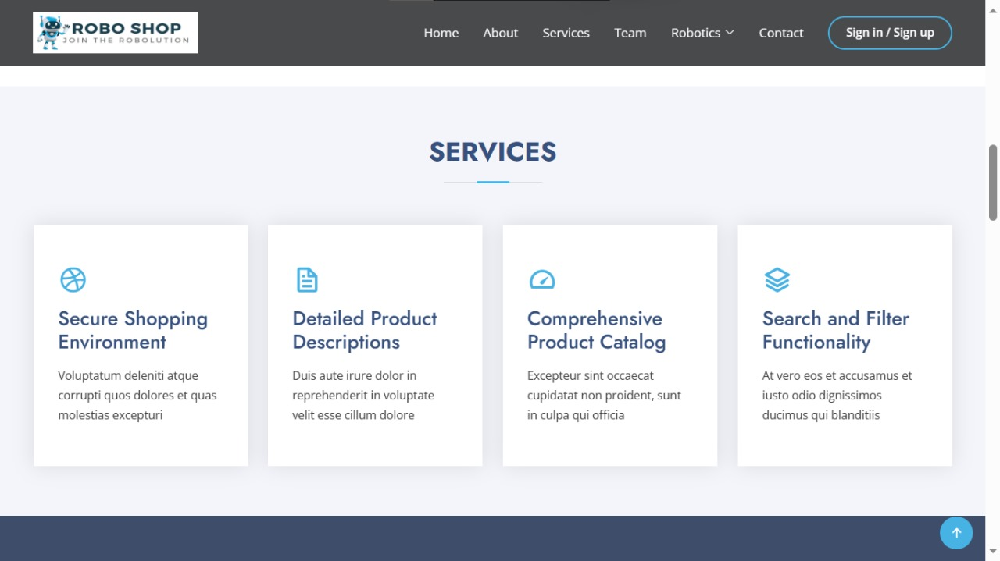
Our Services

Slide 7
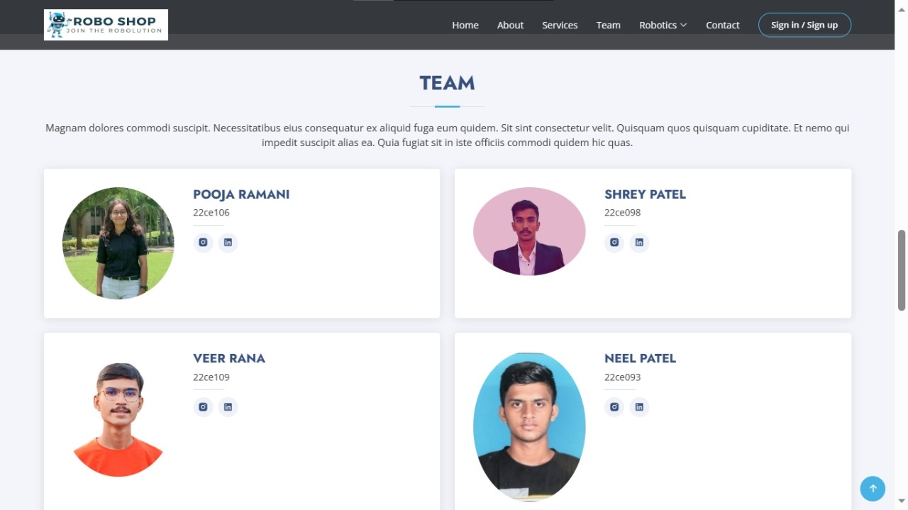
Team Members

Slide 8
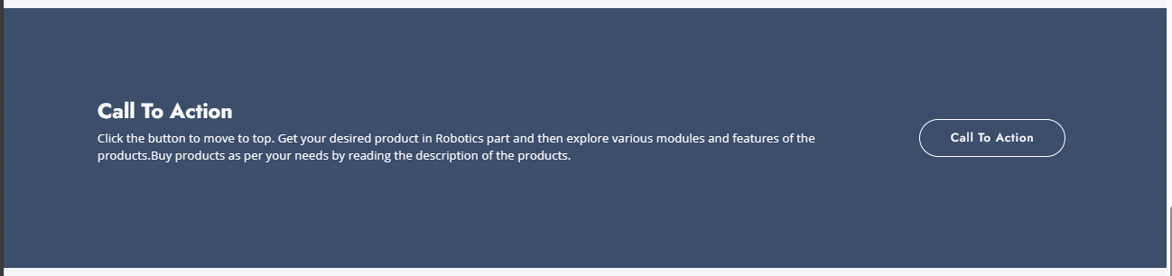

Slide 9
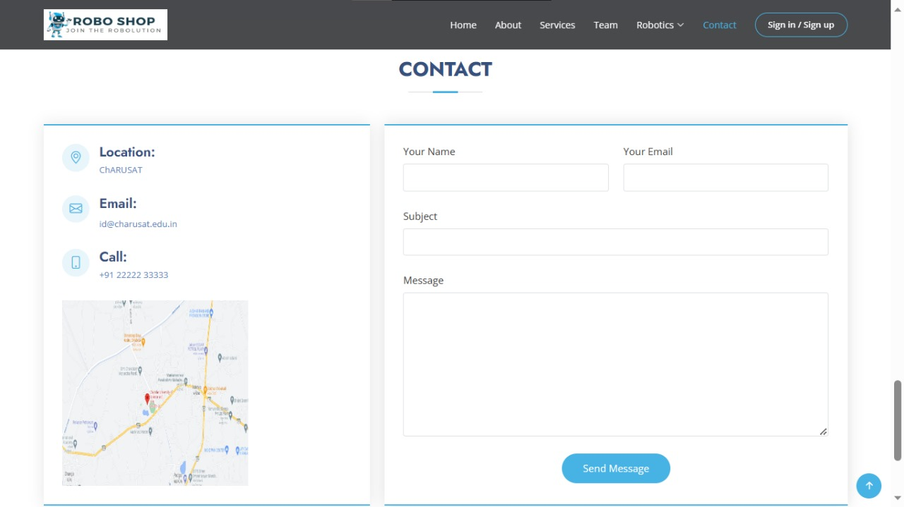
Contact Us

Slide 10
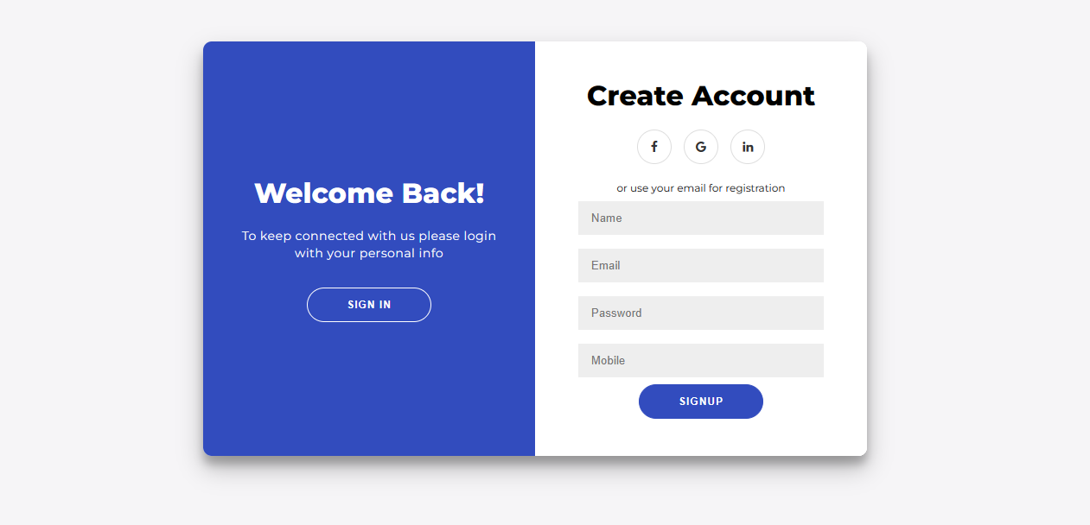
Sign-up

Slide 11
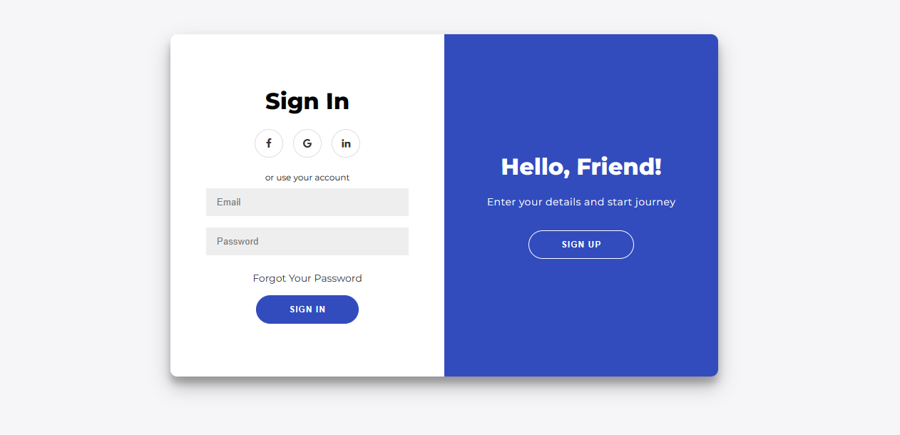
Sign-in

Slide 12
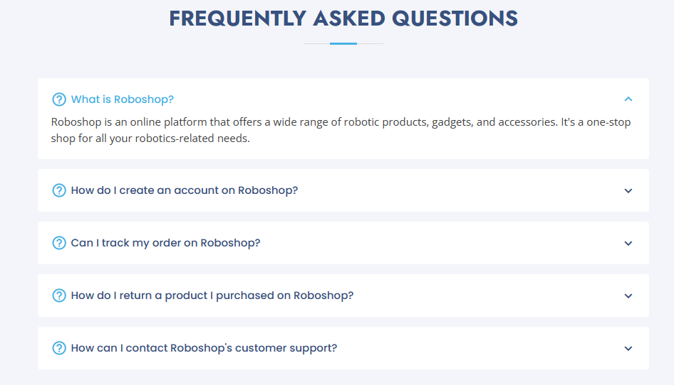

Slide 13
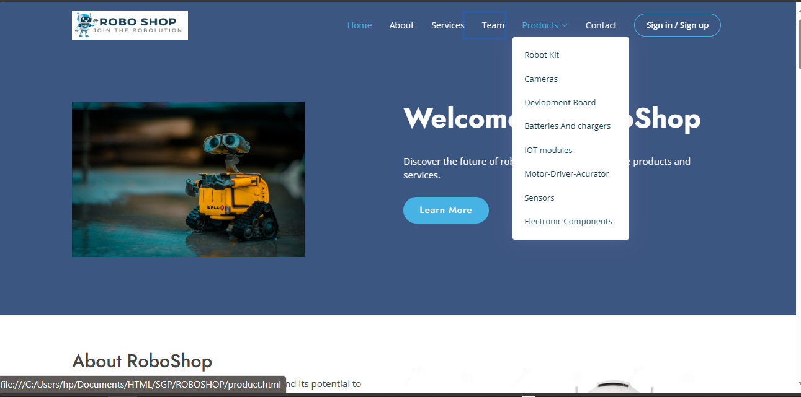
Subpart of our website

Slide 14
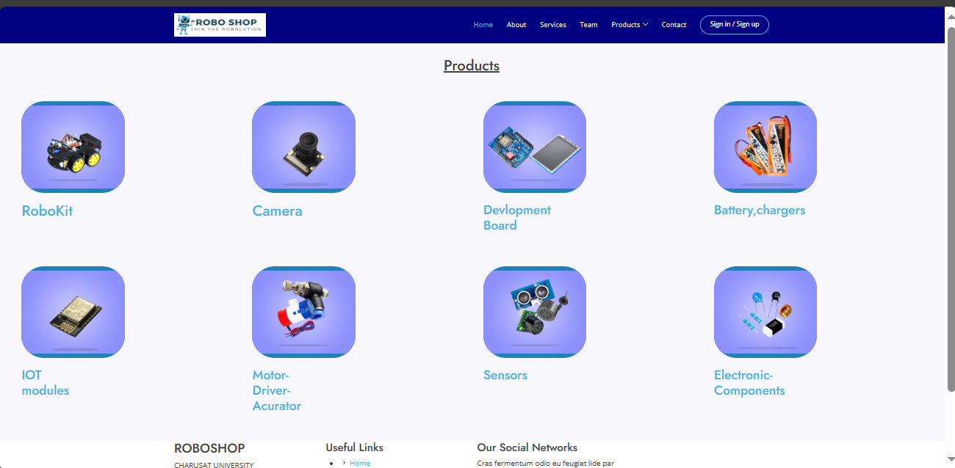
Products

Slide 15
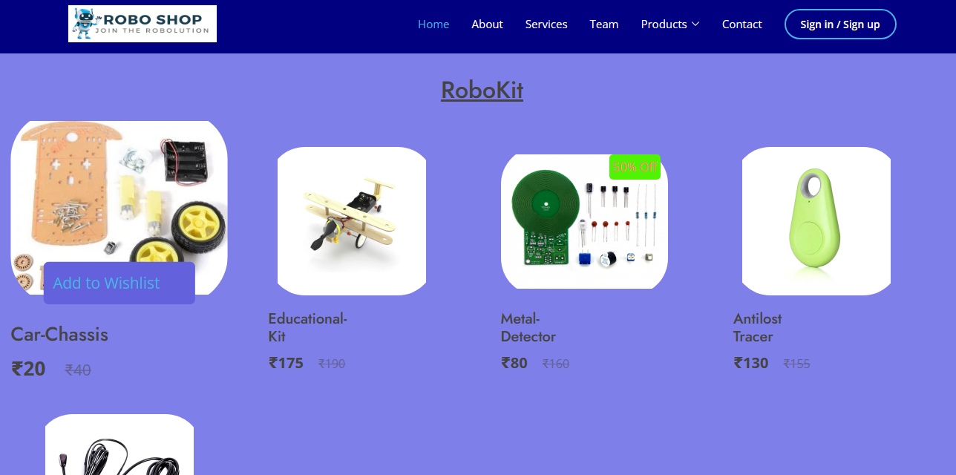
RoboKit

Slide 16
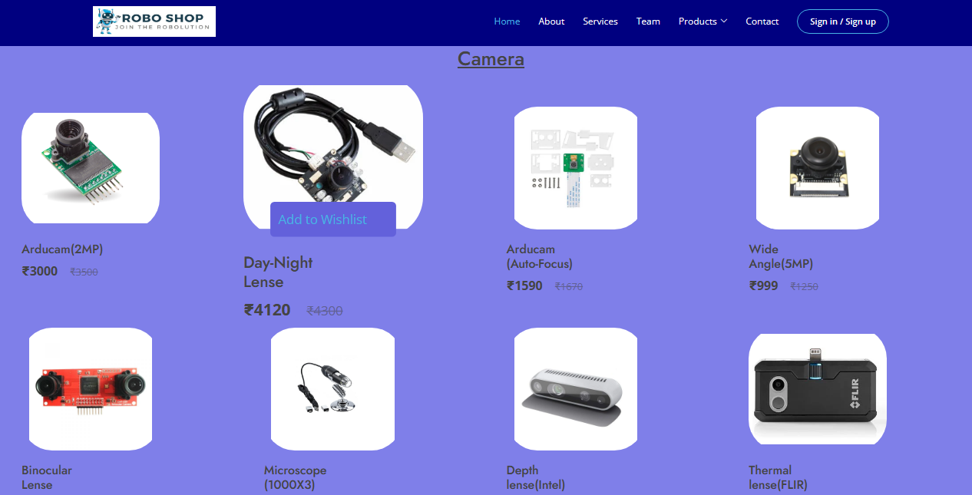
Camera

Slide 17
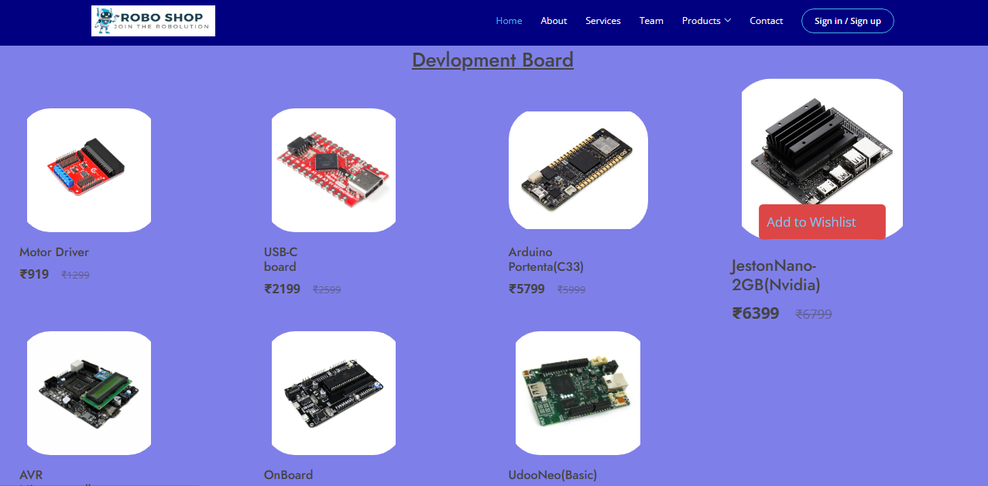
Development Board

Slide 18
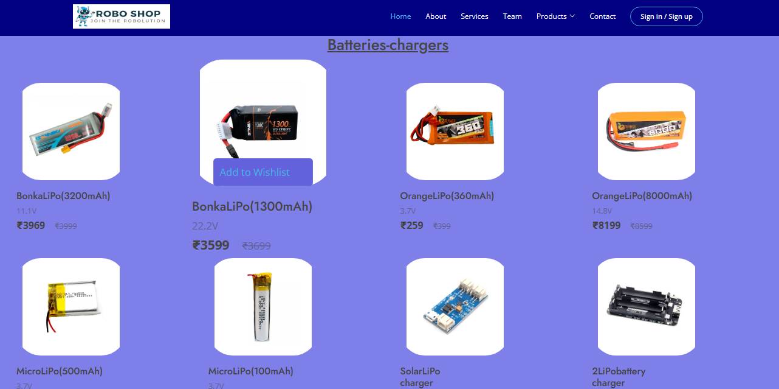
Batteries-Chargers

Slide 19
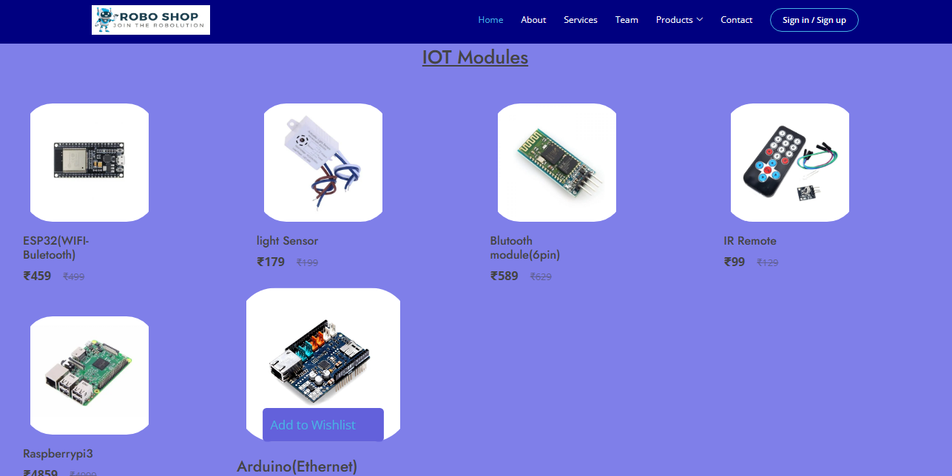
IOT Modules

Slide 20
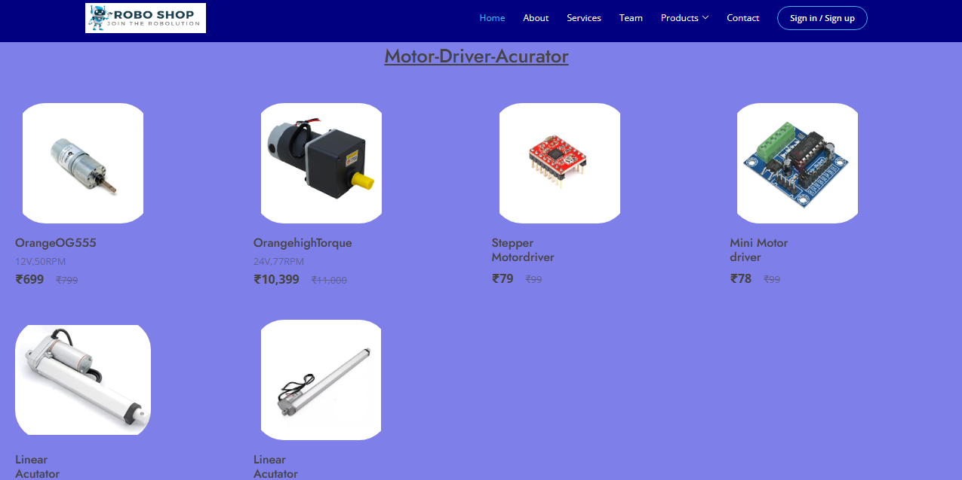
Motor - Driver - Acurator

Slide 21
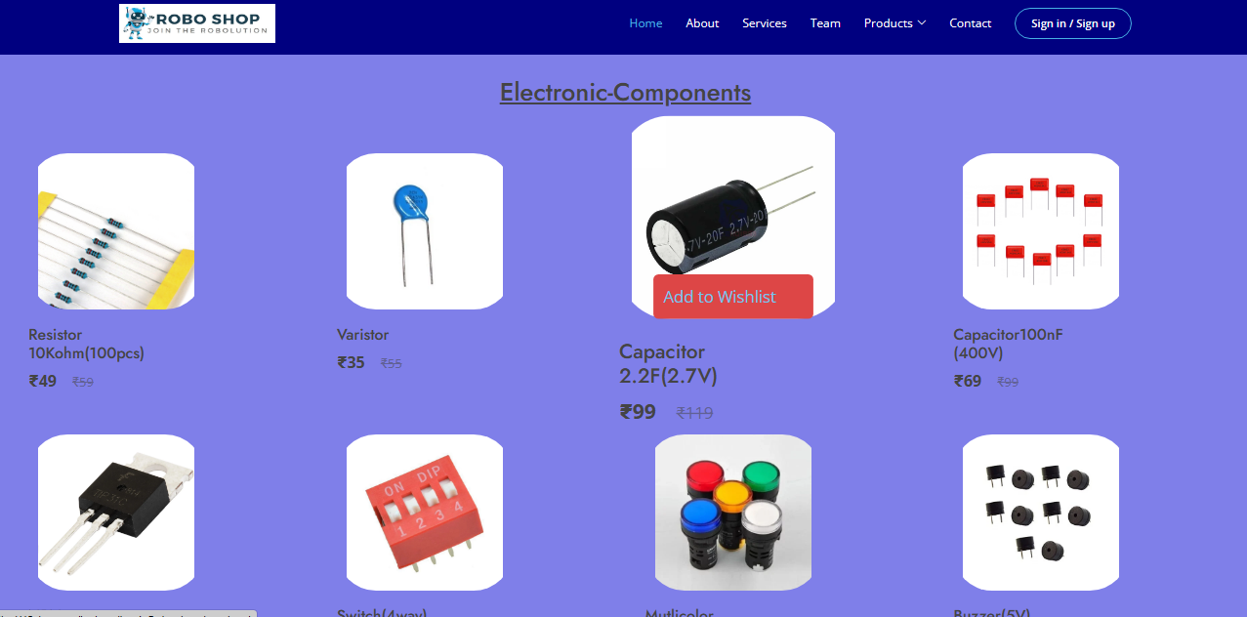
Sensors

Slide 22
Electronic-Components

Slide 23
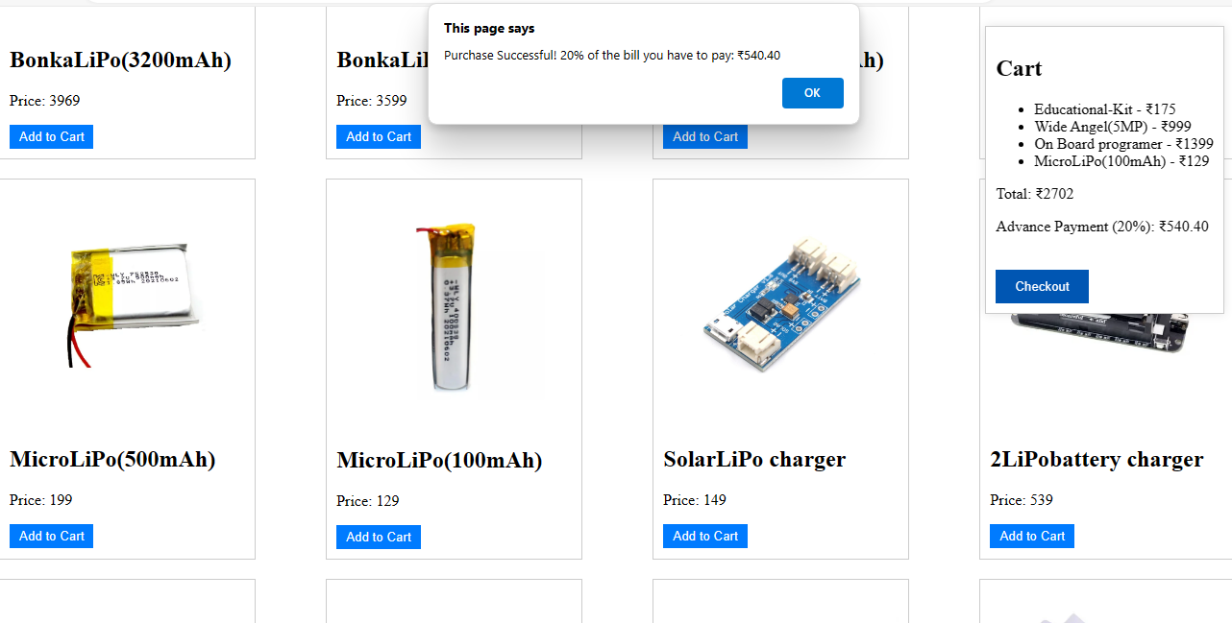
My-Cart

Slide 24
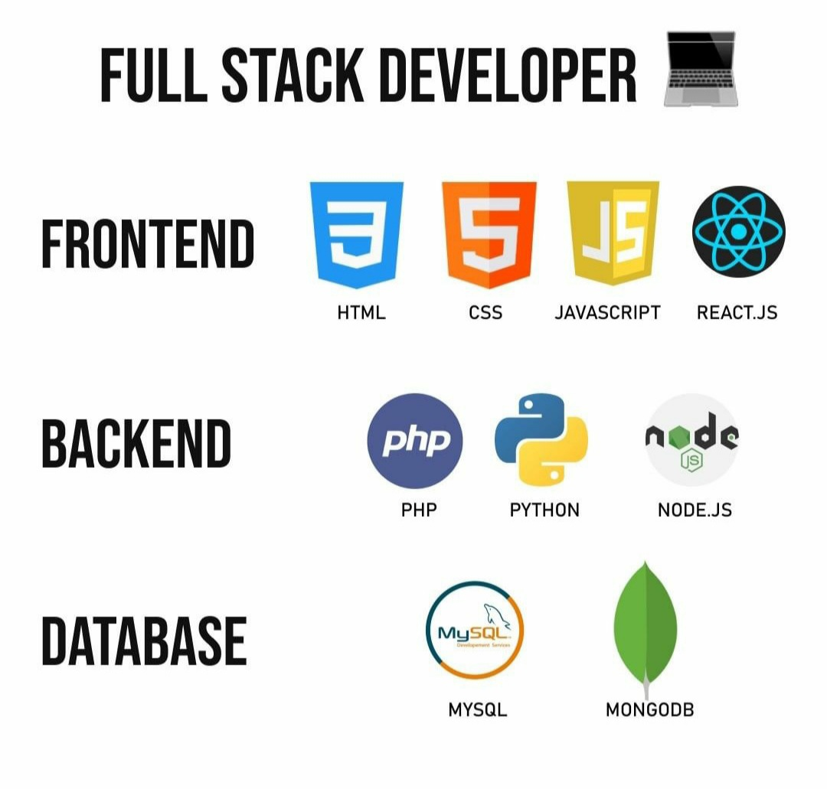
Our Work:

Slide 25
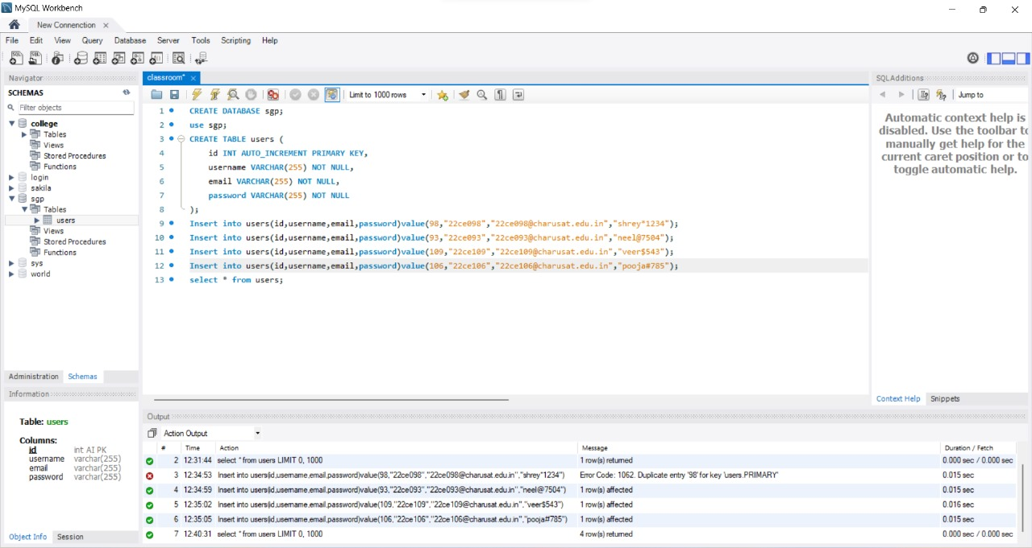
Database(MySQL)

Slide 26
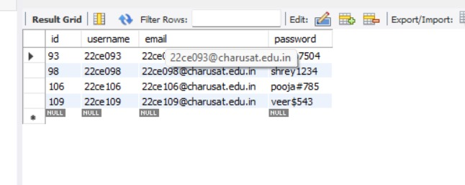
Database(MySQL)

Slide 27
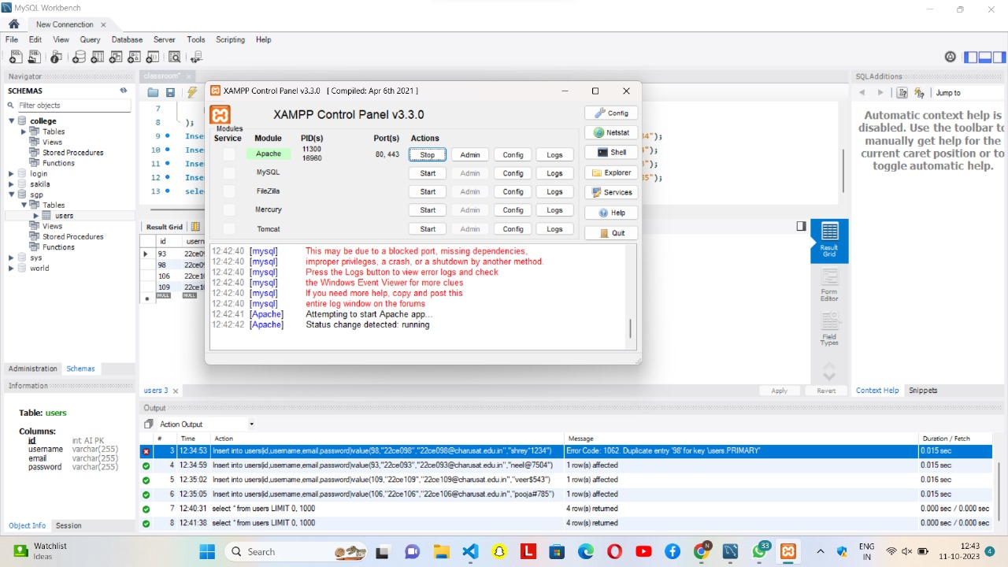
Database(MySQL)

Slide 28

Guided by
Asif Sir
Ayushi Mam

